Slide 1
Introduction to Microsoft Prism Framework
Chris Weldon
Improving Enterprises

Slide 2
Chris Weldon - @neraath
Fightin’ Texas Aggie
C# Developer since 2005
SharePoint 2010 and Identity Management
Sr. Consultant at Improving Enterprises
chris@chrisweldon.net

Slide 3
@neraath
#exxon
#prism
#awesomespeaker
#wickedtopic
#horrible
#omgwtfshootme

Slide 4


Slide 5
Chart a Course
Evolution of Thick Client Apps
Intro to Prism
Prism Features
Modular Application Development
Event Aggregator
Regions and the Region Manager
View Composition
Navigation

Slide 6


Slide 7
Evolution of Thick Client Apps

Slide 8
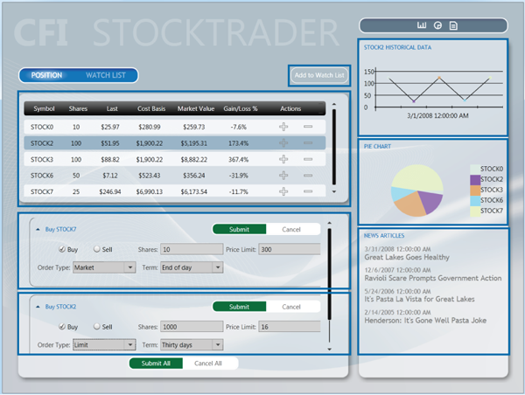

Slide 9
namespace StockTrader
{ public partial class Form1 : Form { int selrow; public Form1() { InitializeComponent(); } private void Form1_Load(object sender, EventArgs e) { DataTable dt = new DataTable(); DataRow dr; dt.Columns.Add(“Symbol"); dt.Columns.Add(“Shares"); dt.Columns.Add(“Last");
// A LOT MORE CRUD dataGridView1.DataSource = dt; } private void dataGridView1_RowEnter(object sender, DataGridViewCellEventArgs e) { selrow = e.RowIndex; } private void button1_Click(object sender, EventArgs e) { //Create instance of second form Form2 obj = new Form2(); //Assign Employee No from grid view to second form textbox obj.Controls["TextBox1"].Text = dataGridView1.Rows[selrow].Cells[0].Value.ToString(); //Assign Employee Name from grid view to second form textbox obj.Controls["TextBox2"].Text = dataGridView1.Rows[selrow].Cells[1].Value.ToString(); //Assign Employee Salary from grid view to second form textbox obj.Controls["TextBox3"].Text = dataGridView1.Rows[selrow].Cells[2].Value.ToString(); //Open Details form obj.ShowDialog(); } } }

Slide 10

Form1.Designer.cs
I don’t want to show you
Because it’s a big pile of

Slide 11
WPF
<UserControl x:Class=“StockTrader.AddFundView"
xmlns="http://schemas.microsoft.com/winfx/2006/xaml/presentation"
xmlns:x="http://schemas.microsoft.com/winfx/2006/xaml"
Width="Auto">
<StackPanel>
<Label>Customer:</Label>
<ComboBox Name="CustomerCbx" Margin="5" Style="{DynamicResource SimpleComboBox}"
Width="Auto" HorizontalAlignment="Stretch">
<ComboBoxItem>Customer1</ComboBoxItem>
<ComboBoxItem>Customer2</ComboBoxItem>
</ComboBox>
<Label>Fund:</Label>
<ComboBox Name="FundCbx" Margin="5" Style="{DynamicResource SimpleComboBox}"
Width="Auto" HorizontalAlignment="Stretch">
<ComboBoxItem>FundA</ComboBoxItem>
<ComboBoxItem>FundB</ComboBoxItem>
</ComboBox>
<Button Name="AddButton" Margin="5" Width="75" Height="25"
Style="{DynamicResource SimpleButton}" HorizontalAlignment="Left">Add</Button>
</StackPanel>
</UserControl>

Slide 12
namespace StockTrader
{ public partial class AddFundView : UserControl { int selrow; public AddFundView() { InitializeComponent(); } private void dataGridView1_RowEnter(object sender, DataGridViewCellEventArgs e) { selrow = e.RowIndex; }
private void button1_Click(object sender, EventArgs e) { //Create instance of second form Form2 obj = new Form2(); //Assign Employee No from grid view to second form textbox obj.Controls["TextBox1"].Text = dataGridView1.Rows[selrow].Cells[0].Value.ToString(); //Assign Employee Name from grid view to second form textbox obj.Controls["TextBox2"].Text = dataGridView1.Rows[selrow].Cells[1].Value.ToString(); //Assign Employee Salary from grid view to second form textbox obj.Controls["TextBox3"].Text = dataGridView1.Rows[selrow].Cells[2].Value.ToString(); //Open Details form obj.ShowDialog(); } } }

Slide 13
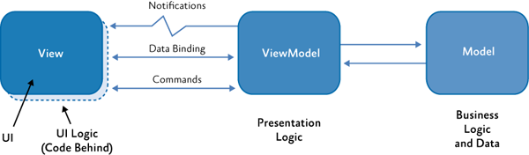
MVVM

Slide 14
When I click a row of a specific type…
I want to add an element here.

Slide 15
private void Grid1_ItemSelected(object sender, EventArgs e)
{
RightPanelStackPanel.Children.Clear(); if (sender.GetType() == typeof(PremiereStock))
{
BestBetsWatcherControl bbwc = new BestBetsWatcherControl();
RightPanelStackPanel.Children.Add(bbwc);
}
else if (sender.GetType() == typeof(PennyStock))
{
CautionWatcherControl cwc = new CautionWatcherControl((PennyStock)sender);
RightPanelStackPanel.Children.Add(cwc);
}
else if (sender.GetType() == typeof(StandardStock))
{
NewsControl news = new NewsControl((StandardStock)sender);
RightPanelStackPanel.Children.Add(news);
}
else
{
// Do nothing?
} }

Slide 16
Conditional Logic == Bad

Slide 17
class BestBetsViewModel : INotifyPropertyChanged
{
public void OnGridItemSelected(object sender, EventArgs e)
{
if (sender.GetType() == typeof(PremiereStock))
{
BestBetsWatcherControl bbwc = new BestBetsWatcherControl((PremiereStock)sender);
RightPanelStackPanel.Children.Add(bbwc);
}
}
}
class CautionWatcherViewModel : INotifyPropertyChanged
{
public void OnGridItemSelected(object sender, EventArgs e)
{
if (sender.GetType() == typeof(PennyStock))
{
CautionWatcherControl cwc = new CautionWatcherControl((PennyStock)sender);
RightPanelStackPanel.Children.Add(cwc);
}
}
}
public RightPanelStackPanel()
{
void bbViewModel = ...;
void cwViewModel = ...;
this.Grid1_ItemSelected += bbViewModel.OnGridItemSelected;
this.Grid1_ItemSelected += cwViewModel.OnGridItemSelected;
}

Slide 18
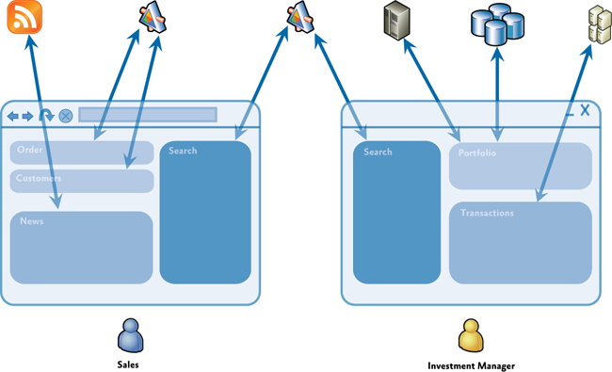
A Composite Example

Slide 19
Composite Goals
Components are loosely coupled
Components easily integrate into coherent “shell”
Promotes reuse while maintaining separation of concerns
Allow independent development by multiple modular teams

Slide 20
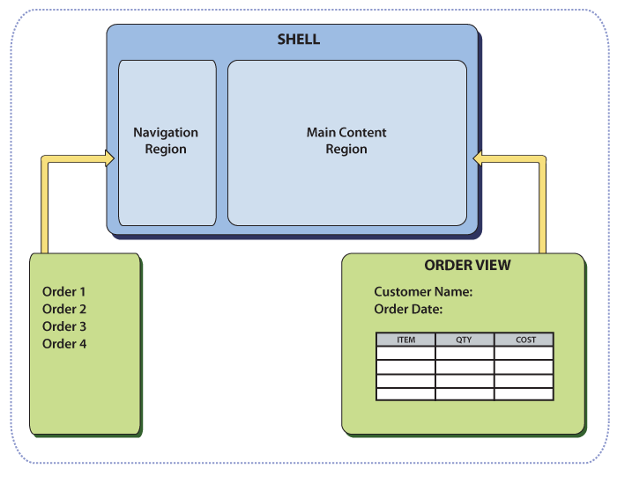
Composite View Design Pattern

Slide 21
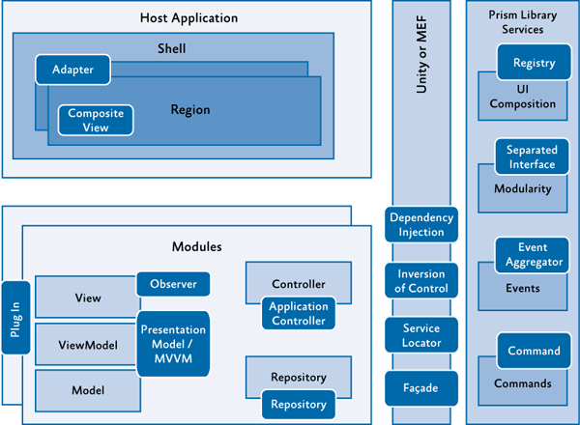
Patterns Used in Prism

Slide 22
Modular Development

Slide 23
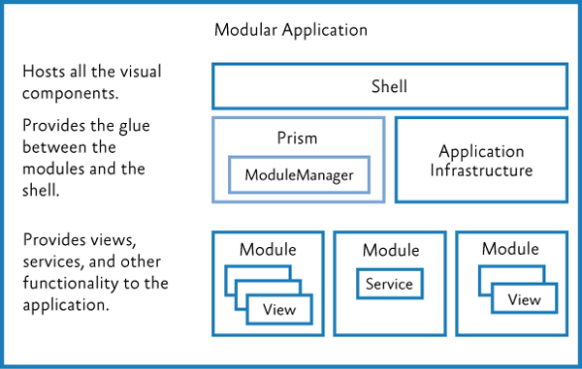

Slide 24
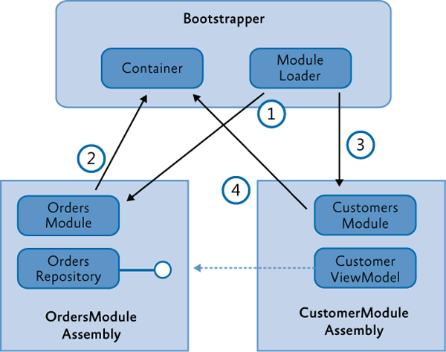
Dependency Injection

Slide 25
Prism and IoC
Supports any IoC container
Has OOB Support for
MEF
Unity

Slide 26
Prism Modules
public interface IModule
{
void Initialize();
}

Slide 27
MEF Modules
[ModuleExport(typeof(ModuleB))]
public class ModuleB : IModule
{
...
}

Slide 28
Module Catalogs (XAML)
<Modularity:ModuleCatalog
xmlns="http://schemas.microsoft.com/winfx/2006/xaml/presentation"
xmlns:x="http://schemas.microsoft.com/winfx/2006/xaml"
xmlns:sys="clr-namespace:System;assembly=mscorlib"
xmlns:Modularity="clr-namespace:Microsoft.Practices.Prism.Modularity;assembly=Microsoft.Practices.Prism">
<Modularity:ModuleInfoGroup Ref="ModuleB.xap" InitializationMode="WhenAvailable">
<Modularity:ModuleInfo ModuleName="ModuleB"
ModuleType="ModuleB.ModuleB, ModuleB, Version=1.0.0.0, Culture=neutral, PublicKeyToken=null" />
</Modularity:ModuleInfoGroup>
<Modularity:ModuleInfoGroup InitializationMode="OnDemand">
<Modularity:ModuleInfo Ref="ModuleE.xap" ModuleName="ModuleE"
ModuleType="ModuleE.ModuleE, ModuleE, Version=1.0.0.0, Culture=neutral, PublicKeyToken=null" />
<Modularity:ModuleInfo Ref="ModuleF.xap" ModuleName="ModuleF"
ModuleType="ModuleF.ModuleF, ModuleF, Version=1.0.0.0, Culture=neutral, PublicKeyToken=null" >
<Modularity:ModuleInfo.DependsOn>
<sys:String>ModuleE</sys:String>
</Modularity:ModuleInfo.DependsOn>
</Modularity:ModuleInfo>
</Modularity:ModuleInfoGroup>
<!-- Module info without a group -->
<Modularity:ModuleInfo Ref="ModuleD.xap" ModuleName="ModuleD"
ModuleType="ModuleD.ModuleD, ModuleD, Version=1.0.0.0, Culture=neutral, PublicKeyToken=null" />
</Modularity:ModuleCatalog>

Slide 29
Module Catalogs (XAML)
protected override IModuleCatalog CreateModuleCatalog()
{
return ModuleCatalog.CreateFromXaml(
new Uri("/MyProject.Silverlight;component/ModulesCatalog.xaml", UriKind.Relative));
}

Slide 30
Module Catalogs (Config)
<?xml version="1.0" encoding="utf-8" ?>
<configuration>
<configSections>
<section name="modules" type="Microsoft.Practices.Prism.Modularity.ModulesConfigurationSection, Microsoft.Practices.Prism"/>
</configSections>
<modules>
<module assemblyFile="ModularityWithUnity.Desktop.ModuleE.dll"
moduleType="ModularityWithUnity.Desktop.ModuleE, ..." moduleName="ModuleE" startupLoaded="false" />
<module assemblyFile="ModularityWithUnity.Desktop.ModuleF.dll"
moduleType="ModularityWithUnity.Desktop.ModuleF, ..." moduleName="ModuleF" startupLoaded="false">
<dependencies>
<dependency moduleName="ModuleE"/>
</dependencies>
</module>
</modules>
</configuration>

Slide 31
Module Catalogs (Config)
protected override IModuleCatalog CreateModuleCatalog()
{
return new ConfigurationModuleCatalog();
}

Slide 32
Module Catalogs (Directory)
protected override IModuleCatalog CreateModuleCatalog()
{
return new DirectoryModuleCatalog() {ModulePath = @".\Modules"};
}

Slide 33
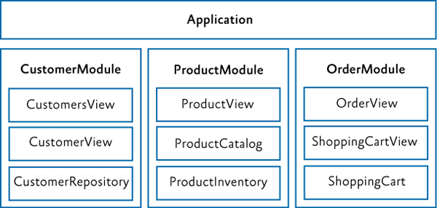
Vertical Slicing

Slide 34
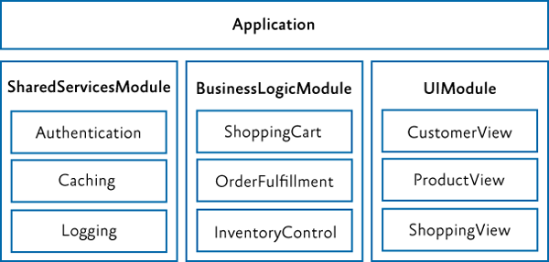
Horizontal Slicing

Slide 35
Number of Modules
Not uncommon to have 10-50 for large applications
Recommend one module per project
Keeps logical modules separate
Promotes proper encapsulation
Easier deployment

Slide 36
Communicating between Modules

Slide 37
ICommand
RoutedCommand helps to route command execution and handling up and down the visual tree
CompositeCommand allows multiple commands to be chained
Supports enablement via CanExecuteChanged and CanExecute

Slide 38
public class ArticleViewModel : NotificationObject
{
private readonly ICommand showArticleListCommand;
public ArticleViewModel(INewsFeedService newsFeedService,
IRegionManager regionManager,
IEventAggregator eventAggregator)
{
this.showArticleListCommand = new DelegateCommand(this.ShowArticleList);
}
public ICommand ShowArticleListCommand
{
get { return this.showArticleListCommand; }
}
}

Slide 39
public class MyViewModel : NotificationObject
{
private readonly CompositeCommand saveAllCommand;
public ArticleViewModel(INewsFeedService newsFeedService,
IRegionManager regionManager,
IEventAggregator eventAggregator)
{
this.saveAllCommand = new CompositeCommand();
this.saveAllCommand.RegisterCommand(new SaveProductsCommand());
this.saveAllCommand.RegisterCommand(new SaveOrdersCommand());
}
public ICommand SaveAllCommand
{
get { return this.saveAllCommand; }
}
}

Slide 40


Slide 41
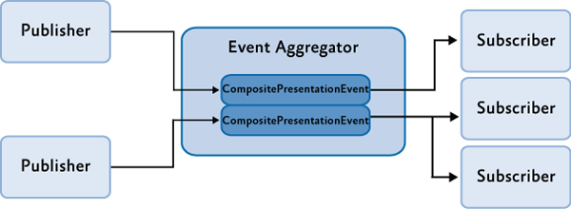
Event Aggregator

Slide 42
public interface IEventAggregator
{
TEventType GetEvent<TEventType>() where TEventType : EventBase;
}

Slide 43
public class CompositePresentationEvent<TPayload> : EventBase
{
...
public SubscriptionToken Subscribe(Action<TPayload> action);
public SubscriptionToken Subscribe(Action<TPayload> action, ThreadOption threadOption);
public SubscriptionToken Subscribe(Action<TPayload> action, bool keepSubscriberReferenceAlive)
public virtual SubscriptionToken Subscribe(Action<TPayload> action, ThreadOption threadOption,
bool keepSubscriberReferenceAlive);
public virtual SubscriptionToken Subscribe(Action<TPayload> action, ThreadOption threadOption,
bool keepSubscriberReferenceAlive, Predicate<TPayload> filter);
public virtual void Publish(TPayload payload);
public virtual void Unsubscribe(Action<TPayload> subscriber);
public virtual bool Contains(Action<TPayload> subscriber)
...
}

Slide 44
public class TickerSymbolSelectedEvent : CompositePresentationEvent<string>{}

Slide 45
Publishing and Subscribing
this.eventAggregator.GetEvent<TickerSymbolSelectedEvent>().Publish("STOCK0");
public void Run()
{
...
this.eventAggregator.GetEvent<TickerSymbolSelectedEvent>()
.Subscribe(ShowNews, ThreadOption.UIThread);
}
public void ShowNews(string companySymbol)
{
this.articlePresentationModel.SetTickerSymbol(companySymbol);
}

Slide 46
Subscription Filtering
FundAddedEvent fundAddedEvent = this.eventAggregator.GetEvent<FundAddedEvent>();
fundAddedEvent.Subscribe(FundAddedEventHandler, ThreadOption.UIThread, false,
fundOrder => fundOrder.CustomerId == this.customerId);

Slide 47
UI Composition

Slide 48
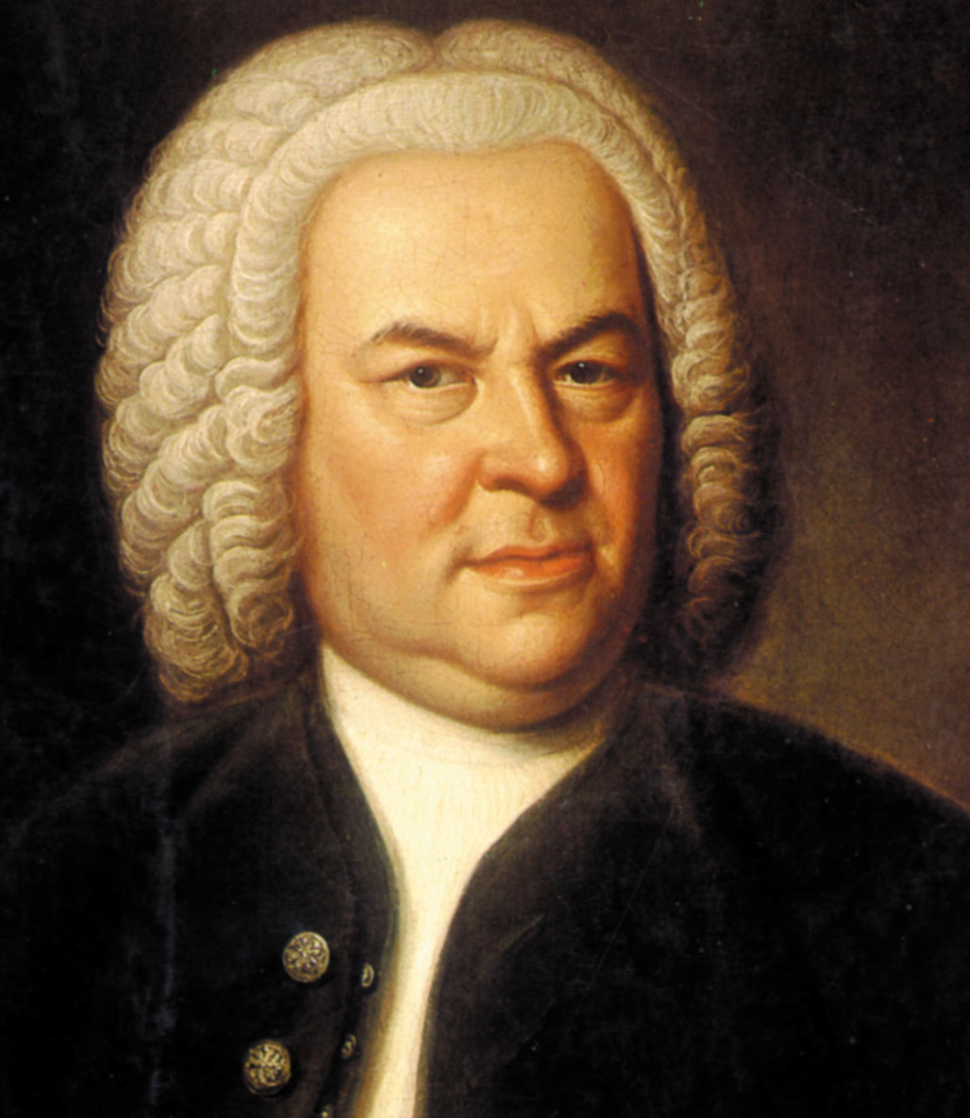

Slide 49
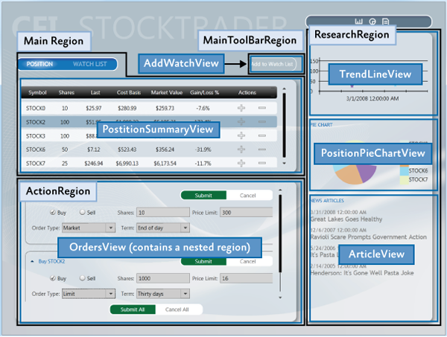

Slide 50
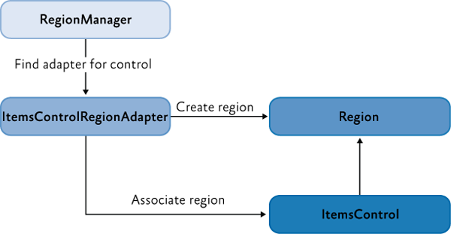
Regions and RegionManager

Slide 51
Regions
Logical placeholders for UI elements
Can hold any UI content, including DataTemplates
Additional Behaviors can be attached to Regions
Registration Behavior
Auto-Population Behavior (View Discovery)
Region Context Behavior
Activation Behavior
Region Lifetime Behavior

Slide 52
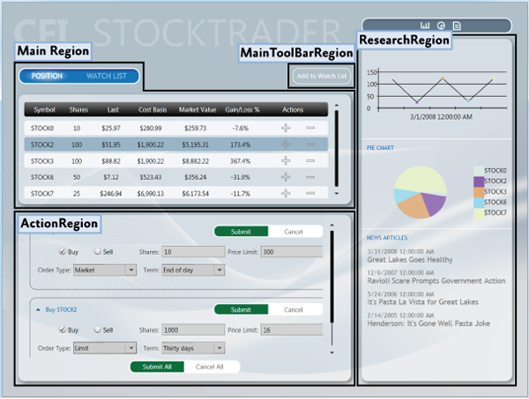

Slide 53
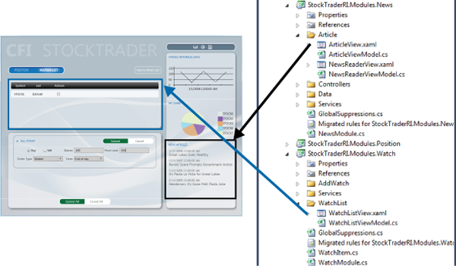

Slide 54
public interface IRegion : INavigateAsync, INotifyPropertyChanged
{
IViewsCollection Views { get; }
IViewsCollection ActiveViews { get; }
object Context { get; set; }
string Name { get; set; }
Comparison<object> SortComparison { get; set; }
IRegionManager Add(object view);
IRegionManager Add(object view, string viewName);
IRegionManager Add(object view, string viewName, bool createRegionManagerScope);
void Remove(object view);
void Deactivate(object view);
object GetView(string viewName);
IRegionManager RegionManager { get; set; }
IRegionBehaviorCollection Behaviors { get; }
IRegionNavigationService NavigationService { get; set; }
}

Slide 55
Defining a Region (XAML)
<Controls:AnimatedTabControl x:Name="PositionBuySellTab"
cal:RegionManager.RegionName="{x:Static inf:RegionNames.MainRegion}"/>

Slide 56
Defining a Region (Code)
IRegionManager regionManager = ServiceLocator.Current.GetInstance<IRegionManager>();
RegionManager.SetRegionManager(this.ActionContent, regionManager);
RegionManager.SetRegionName(this.ActionContent, "ActionRegion");

Slide 57
View-Based Composition
<ContentControl prism:RegionManager.RegionName="MainRegion" ... />

Slide 58


Slide 59


Slide 60
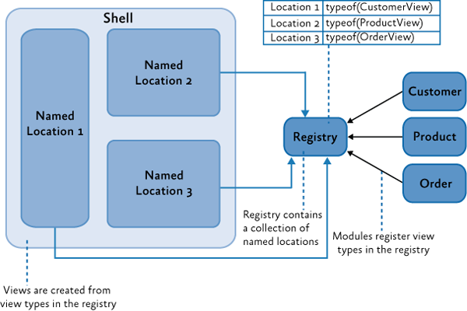
View Discovery

Slide 61
View Discovery
IRegionManager regionManager = ...;
regionManager.RegisterViewWithRegion("MainRegion", () =>
container.Resolve<InboxView>());

Slide 62
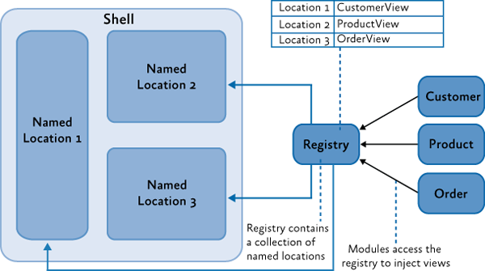
View Injection

Slide 63
View Injection
IRegionManager regionManager = ...;
IRegion mainRegion = regionManager.Regions["MainRegion"];
InboxView view = this.container.Resolve<InboxView>();
mainRegion.Add(view);

Slide 64
Ordering Views
[Export]
[ViewSortHint("01")]
public partial class EmailNavigationItemView
[Export]
[ViewSortHint("02")]
public partial class CalendarNavigationItemView
[Export]
[ViewSortHint("03")]
public partial class ContactsDetailNavigationItemView
[Export]
[ViewSortHint("04")]
public partial class ContactsAvatarNavigationItemView

Slide 65
RegionManager
Can have multiple localized RegionManagers
Useful to contain module region boundaries
Keeps module view elements from being added to Global Regions

Slide 66
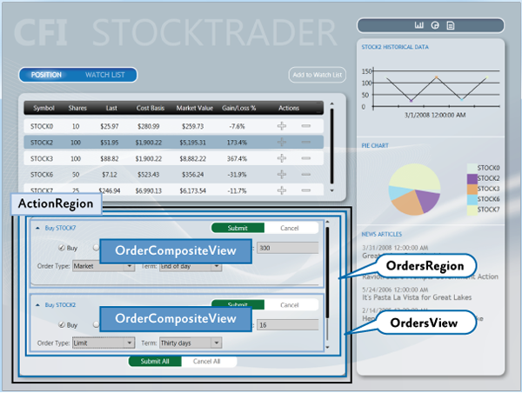

Slide 67
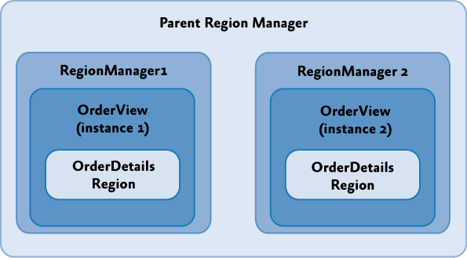

Slide 68
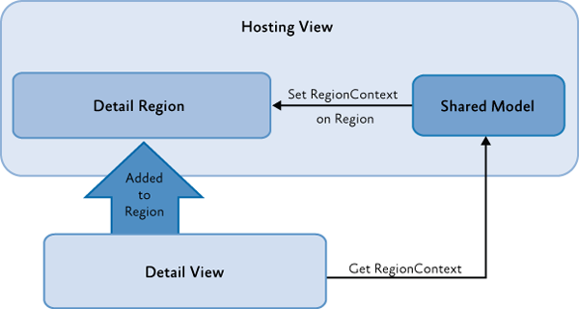
RegionContext

Slide 69
RegionContext
<TabControl AutomationProperties.AutomationId="DetailsTabControl"
cal:RegionManager.RegionName="{x:Static local:RegionNames.TabRegion}"
cal:RegionManager.RegionContext="{Binding Path=SelectedEmployee.EmployeeId}"
...>

Slide 70
Navigation

Slide 71


Slide 72
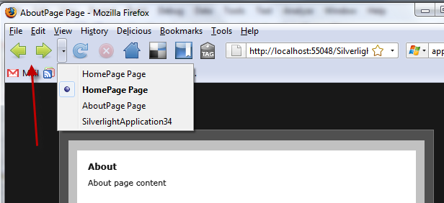

Slide 73
Navigation is Broad
As simple as adding or removing elements from the visual tree based on state changes
As complex as sets of forms with business rules preventing moving between forms
Ultimately: if the UI changes, it can be considered “navigation”

Slide 74
Two Forms of Navigation
State-Based Navigation
State changes to existing controls in visual tree
View-Based Navigation
Addition or removal of elements from the visual tree

Slide 75
State-Based Navigation
<DataStateBehavior Binding="{Binding IsChecked, ElementName=ShowAsListButton}"
TrueState="ShowAsList" FalseState="ShowAsIcons"/>
<DataStateBehavior Binding="{Binding ConnectionStatus}"
TrueState="Available" FalseState="Unavailable"/>

Slide 76
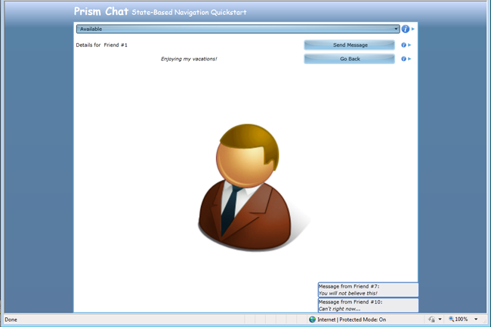

Slide 77
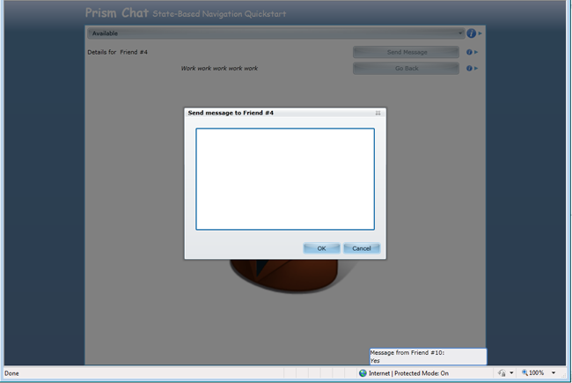

Slide 78
State-Based Navigation
<prism:InteractionRequestTrigger SourceObject="{Binding SendMessageRequest}">
<prism:PopupChildWindowAction>
<prism:PopupChildWindowAction.ChildWindow>
<vs:SendMessageChildWindow />
</prism:PopupChildWindowAction.ChildWindow>
</prism:PopupChildWindowAction>
</prism:InteractionRequestTrigger>

Slide 79
View-Based Navigation
Much more complex
Recommended to use Regions to facilitate view changes
View Injection – Dynamic, Frequently Changing
View Discovery – Static, Rarely Changing

Slide 80
Prism 4.0 Made Navigation Easier
URI-based navigation
Extensible navigation mechanism

Slide 81
INavigateAsync
View-First Navigation
IRegion mainRegion = ...;
mainRegion.RequestNavigate(new Uri("InboxView", UriKind.Relative));
IRegionManager regionManager = ...;
regionManager.RequestNavigate("MainRegion",
new Uri("InboxView", UriKind.Relative));
container.RegisterType<object, InboxView>("InboxView");
regionManager.Regions[Constants.MainRegion]
.RequestNavigate(new Uri("InboxView", UriKind.Relative));
[Export("InboxView")]
public partial class InboxView : UserControl

Slide 82
View (Model) Participation
public interface INavigationAware
{
/// Checks whether this is able to handle the nav request.
bool IsNavigationTarget(NavigationContext navigationContext);
/// Called after navigation is complete.
void OnNavigatedTo(NavigationContext navigationContext);
/// Called before navigation begins.
void OnNavigatedFrom(NavigationContext navigationContext);
}

Slide 83
View (Model) Participation
public class EmployeeDetailsViewModel : IRegionMemberLifetime
{
public bool KeepAlive
{
get { return true; }
}
}

Slide 84
View (Model) Participation
public class ComposeEmailViewModel : NotificationObject, IConfirmNavigationRequest
{
private readonly InteractionRequest<Confirmation> confirmExitInteractionRequest;
public ComposeEmailViewModel(IEmailService emailService)
{
this.confirmExitInteractionRequest = new InteractionRequest<Confirmation>();
}
public IInteractionRequest ConfirmExitInteractionRequest
{
get { return this.confirmExitInteractionRequest; }
}
public void IConfirmNavigationRequest.ConfirmNavigationRequest(
NavigationContext navigationContext, Action<bool> continuationCallback)
{
this.confirmExitInteractionRequest.Raise(
new Confirmation {Content = "...", Title = "..."},
c => {continuationCallback(c.Confirmed);});
}
}

Slide 85
View (Model) Participation
<UserControl.Resources>
<DataTemplate x:Name="ConfirmExitDialogTemplate">
<TextBlock HorizontalAlignment="Center" VerticalAlignment="Center" Text="{Binding}"/>
</DataTemplate>
</UserControl.Resources>
<Grid x:Name="LayoutRoot" Background="White">
<ei:Interaction.Triggers>
<prism:InteractionRequestTrigger SourceObject="{Binding ConfirmExitInteractionRequest}">
<prism:PopupChildWindowAction ContentTemplate="{StaticResource ConfirmExitDialogTemplate}"/>
</prism:InteractionRequestTrigger>
</ei:Interaction.Triggers>
...

Slide 86
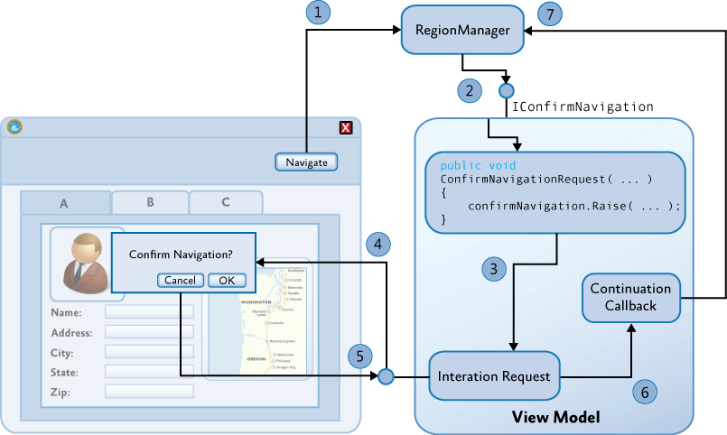

Slide 87
Navigation Service
public interface IRegionNavigationService : INavigateAsync
{
IRegion Region {get; set;}
IRegionNavigationJournal Journal {get;}
event EventHandler<RegionNavigationEventArgs> Navigating;
event EventHandler<RegionNavigationEventArgs> Navigated;
event EventHandler<RegionNavigationFailedEventArgs> NavigationFailed;
}

Slide 88
Navigation Journals
public interface IRegionNavigationJournal
{
bool CanGoBack { get; }
bool CanGoForward { get; }
IRegionNavigationJournalEntry CurrentEntry { get; }
INavigateAsync NavigationTarget { get; set; }
void Clear();
void GoBack();
void GoForward();
void RecordNavigation(IRegionNavigationJournalEntry entry);
}

Slide 89
public class EmployeeDetailsViewModel : INavigationAware
{
...
private IRegionNavigationService navigationService;
public void OnNavigatedTo(NavigationContext navigationContext)
{
navigationService = navigationContext.NavigationService;
}
public DelegateCommand<object> GoBackCommand { get; private set; }
private void GoBack(object commandArg)
{
if (navigationService.Journal.CanGoBack)
{ navigationService.Journal.GoBack();
}
}
private bool CanGoBack(object commandArg)
{
return navigationService.Journal.CanGoBack;
}
}

Slide 90

Q&A

Slide 91

Thanks!
http://spkr8.com/neraath/

